Slide 1
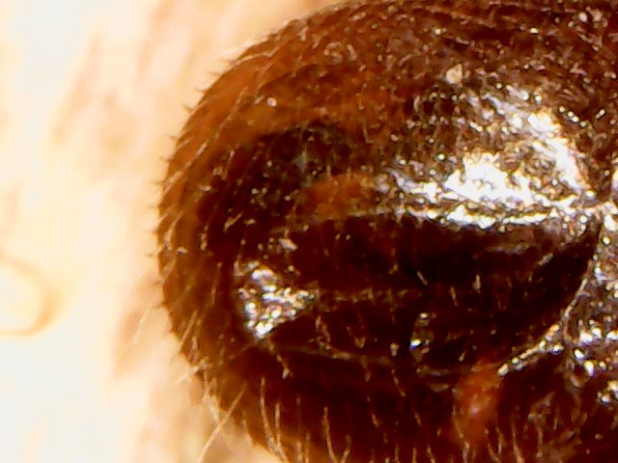
My venture into chemical free beekeeping began in autumn 2015.
I have been keeping bees for four years now, this presentation is an ongoing experiment into chemical free beekeeping which is now in its third year. The only time I have used any type of chemical was back in my first season of 2014.

Slide 2
We were given a very interesting talk by Ron Hoskins at our club house back in the summer of 2015, on hygienic bees, without going into too much detail on his report, which is readily available online, he hasn’t used chemicals for over twenty years. And his bees are still very much alive!
At the end of his talk he encouraged us beekeepers to go get a microscope and have a close look at the varroa mites that had fallen onto the inspection boards, to see if there were signs of the bees helping themselves.
I bought a cheap electronic USB microscope with a camera facility from eBay for £9.99
.
I had two deep national hives at the time, so in the autumn of 2015, a time in the previous year when I was deciding what chemical to drop into my poor girls, I inserted the inspection boards and left them for a week, before i started looking.
BE WARNED, IF YOU DON’T LIKE HAIRY CREEPY CRAWLIES LOOK AWAY NOW.

Slide 3
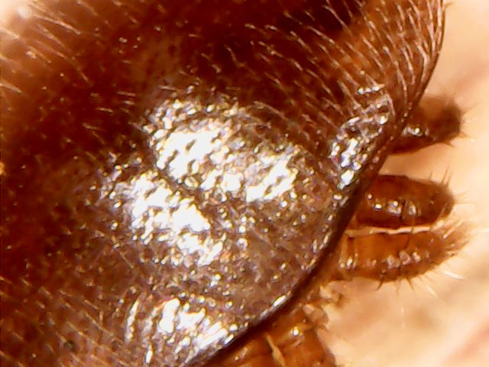
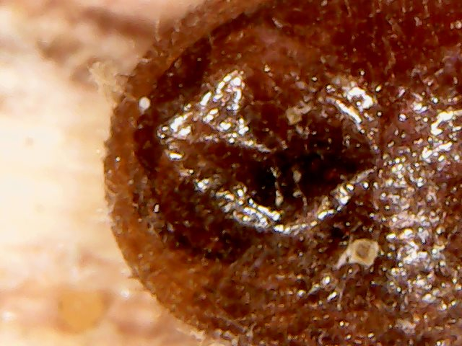
LEFT HAND HIVE AUTUMN 2015
A healthy varroa mite
A varroa with a dented carapace.

Slide 4
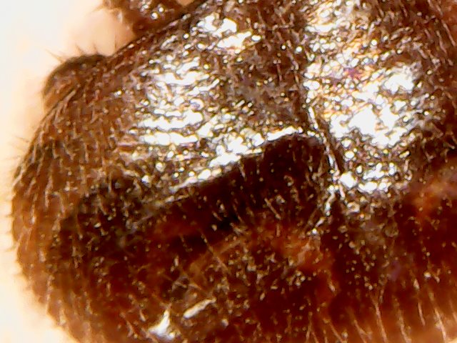
LEFT HAND HIVE AUTUMN 2015
I saw lots of mites with these indentations in their carapaces, they are always roughly the same size and in the same place and to me they have the same shape as a bees mandible.
These mites are still alive at this point, so the bees don’t appear to kill them ,but simply pull them off of each other?
The mites do not have hard bodies like crabs they are quite soft.

Slide 5
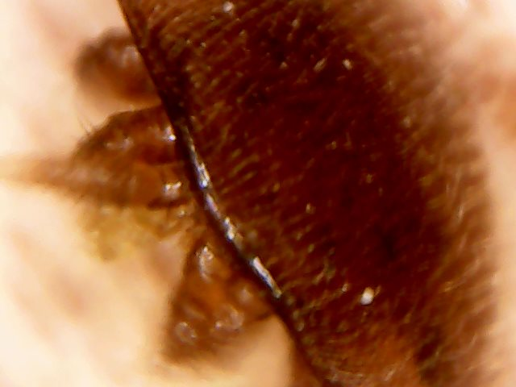
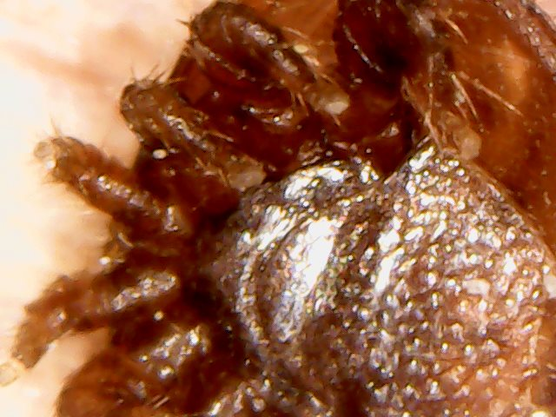
Right hand hive autumn 2015
Healthy mites from above and below

Slide 6
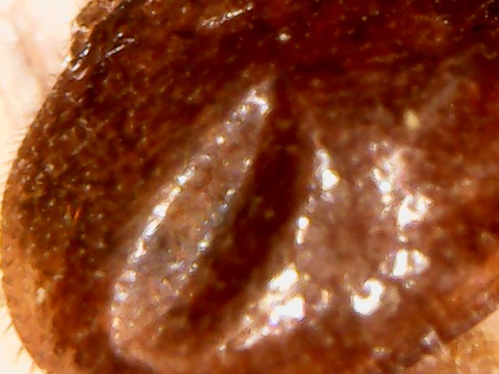
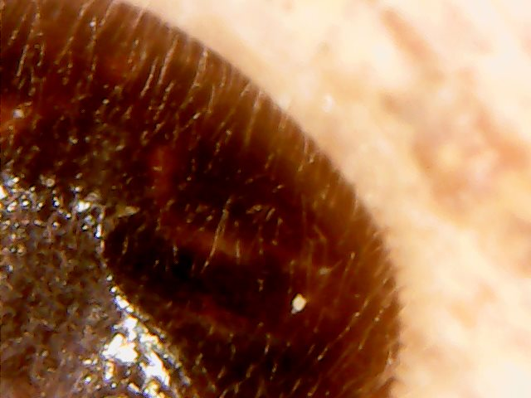
Right hand hive autumn 2015
More indentations in the mites carapaces

Slide 7
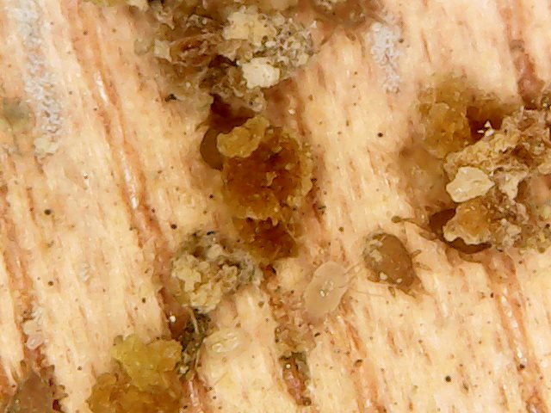
Winter 2015
So with this evidence, in my mind these mites are indeed being bitten off, and it is most defiantly not damage caused by mites just dropping on to the floor. I decided not to treat my girls with any chemicals at all, I did all my normal winter preparations and left them to it.
There are all sorts of mites not just varroa, going about there business on the floor of the hive. I'm sure this eco system plays a part in overall hive health, and I'm equally sure the chemicals used to kill varroa must wipe these chaps out too!

Slide 8
Spring / Summer 2016
To my relief in early spring February the 15th, the bees in both hives were busy bringing in pollen, so all seemed well…
and it was, all season I did no form of varroa control, not even icing sugar. I carried out all the other normal hive husbandry that I've been taught. The bees were thriving, in fact there was so many bees in the right hand hive by June, it was quite frightening!!
At this point I started on my next step of going chemical free and stopped using foundation, brood frames were slowly removed usually in swarm management and making up nuc’s and replaced with foundationless wired frames. The super frames are also being replaced with plastic cellrite frames, you can spin the hell out of that stuff and it doesn't explode.
This process has taken two seasons to achieve.
This has been an interesting experiment. Both colonies which are on 14x12 pulled two complete frames of drone brood each, which flooded the hives and no doubt the whole area with big fat drones. I was told if you have drone size cells in the brood the queen will keep laying drone. NONSENSE, once all the drone had hatched the workers back filled it with honey.
The only down side to this is they have been so busy making wax, the honey production has dropped. Well you can’t have it all I suppose.

Slide 9
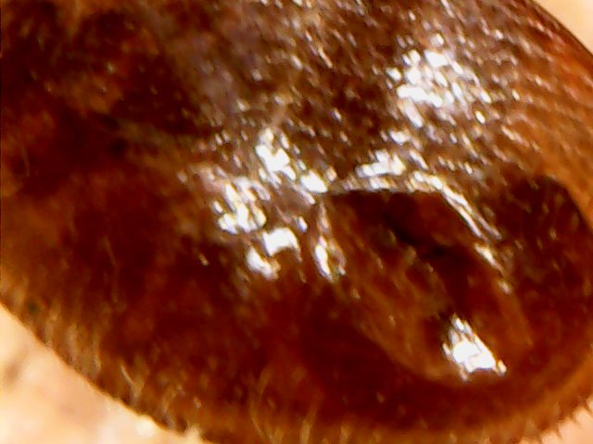
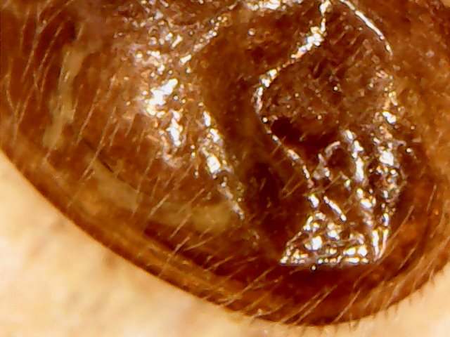
Autumn / Winter 2016
In October / November I carried out the same inspection on the mite drop.
Again, this year what appears to be mandible bites in the usual place. I also saw something different, but not totally unexpected as Ron said this would happen.
Again no chemical was used before winter.

Slide 10
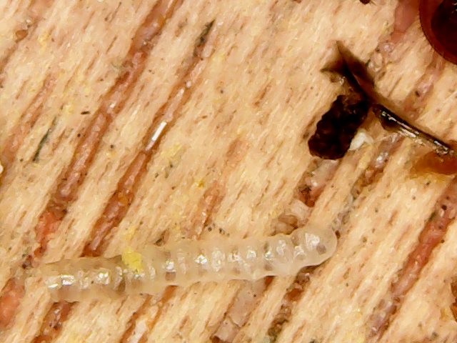
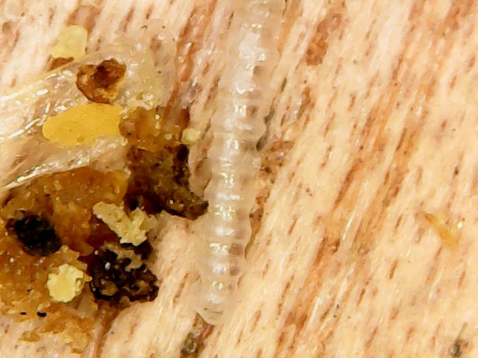
AUTUMN / WINTER 2016
WHAT ON EARTH ARE THESE TRANSPARENT LITTLE TUBES?

Slide 11
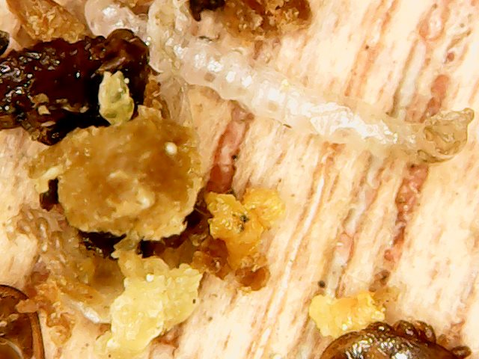
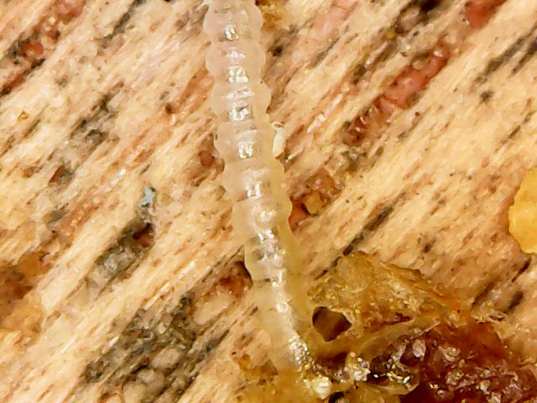
Autumn / Winter 2016
These little tubes are actually the antennae of developing bees. In Ron's research he has found that the bees know which larvae are being effected by varroa mites whilst developing in the cells and remove them. In doing so the antennae are pulled off along with any developing mites still attached to the bee larvae.
If we keep interrupting this kind of behaviour with chemicals, are we only holding up this process? After all nature ALWAYS finds a way.

Slide 12
Spring / Summer 2017
Again, the bees survived a second untreated winter and it was business as usual, the bees were thriving. No obvious level of varroa or visable deformed wing virus.
The two frames of drone cells in each hive were emptied of stores and new drones were produced in there masses again. Once hatched, the cells were once again filled with honey, so the theory the queen will keep laying drone is most defiantly NONSENSE.
By the end of the season all my brood frames have now been replaced with foundationless wired frames.
My reason for this is that most foundation is made from dirty wax returned by other beekeepers, with who knows what concentrated chemical residues in it. It is easy to remove legs and wings through filtering, however I would imagine removing chemicals would be near impossible, and at the very least make foundation unaffordable for those of us that don't live in Bath.

Slide 13
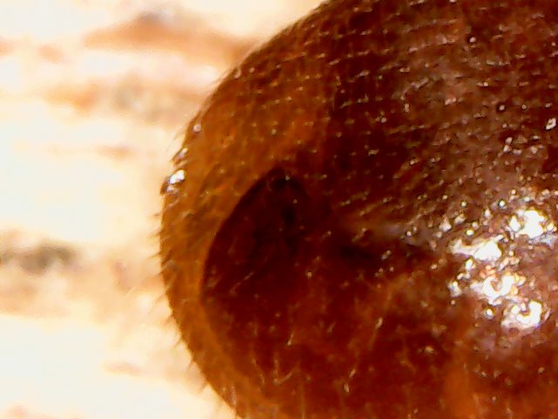
Autumn / Winter 2017
Again, this year there are mites with dent’s in their carapace and lots of transparent
antennae.

Slide 14
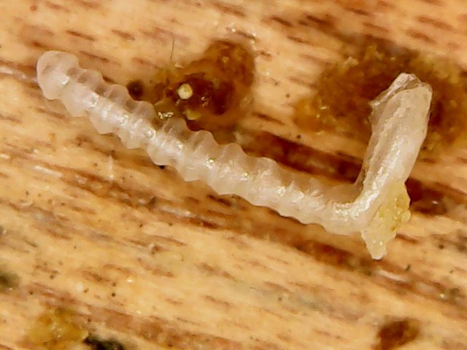
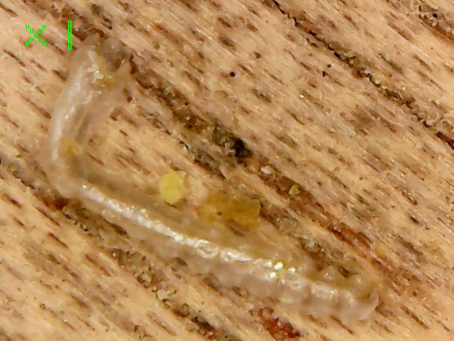
Autumn / Winter 2017
More transparent antennae.

Slide 15
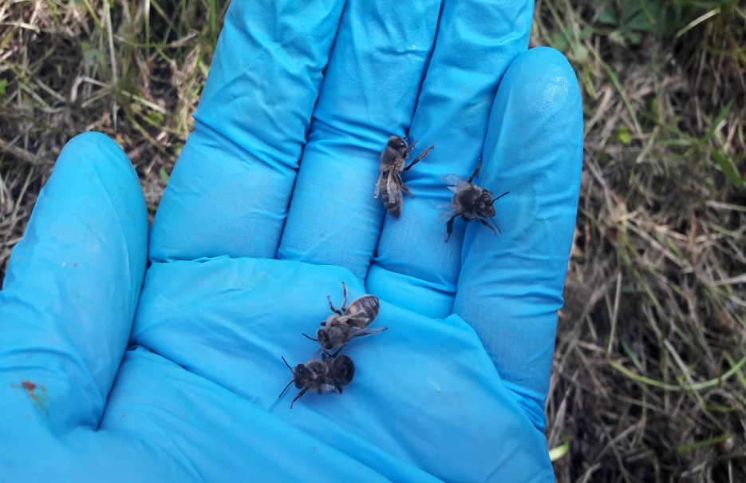
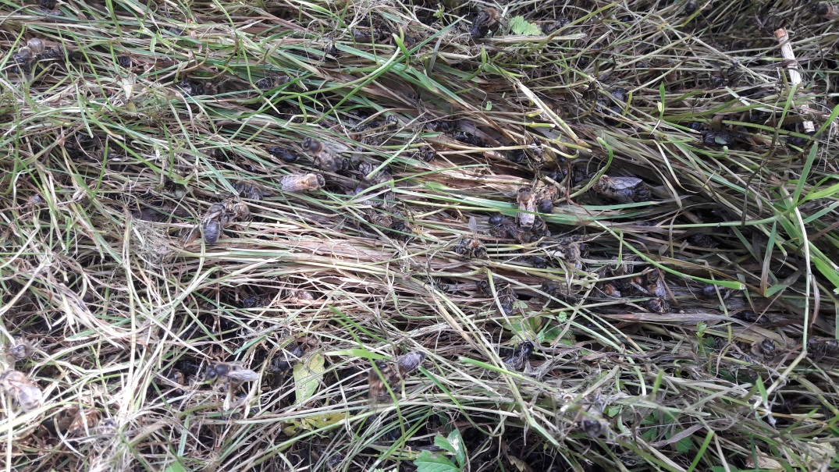
Autumn / Winter 2017
This year I noticed several bees on the ground in front of their hives, that clearly have DWV. I observed the healthy bees pulling these out and dropping them outside.
Earlier in my presentation I said I could see no visible evidence of DWV in the hive, it is possible the bees were removing the infected ones back then.

Slide 16
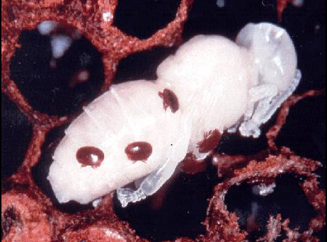
Summing up
As can be seen on this developing larvae the transparent antennae can be clearly seen, these are at the same stage as I have recorded on the hive floor.
At this stage the adult female mite along with her breeding offspring are all present on the young bee.
If my bees are removing larvae from the hive at this stage, they must be interrupting the life cycle of the varroa. No chemical I am aware of currently does this.

Slide 17
Summing up
As far as I am aware, commercially available varroa treatments are only effective on mites that are, not in capped brood cells.
If this is true and my bees are biting these free roaming mites off each other, then why use chemicals to knock them off.
It is not my mission to try and convert any one into not treating their bees, but I would encourage you to have a close look at your inspection boards.
If you see the signs I have shown you, then maybe you can think about trying the same.
Equally, if you don’t see any signs of this behaviour, then you have to continue your normal varroa management.
I also have to stress, I am not a ‘leave it alone beekeeper’ I still carry out all the routine hive management techniques I have been taught by the BBKA and Bath beekeeping association, I have simply removed any type of chemical intervention.
Maybe, just maybe there is another way.

Slide 18
Looking forward to spring 2018
So my bees have gone through three seasons and now into their third winter, with no treatments of any kind.
There are reports that suggest it can take up to three years for a colony to completely collapse from varroa related virus overloads.
My bees seem as healthy as when I used chemical treatment and they are always laid back and very calm.
This is an ongoing experiment, so lets see what year four brings.
I will keep you all posted on the progress.
Or I could be contacting you for some new colonies.
QUESTIONS ?
Many thanks for listening.

